Slide 1
NARZU TARNNUM CSE, BU
Chapter 8: Memory Management
Notes:
1

Slide 2
What we will learn in Memory Management
Background
Swapping
Memory Allocation
Paging
Segmentation
Keep track of every memory location. Take decision which process will get how much memory and when.
Update status of memory location: allocated or free.
Swapping, Protection and security of memory space
Address binding, Address translation
Dynamic loading, linking.

Slide 3
Memory Management
Main memory and registers built into the processor itself are the only storage that the CPU can access directly.
So, any instructions in execution, and any data being used by the instructions, must be in one of these direct-access storage device.
It is the functionality of an operating system which manages primary memory and moves processes back and forth between main memory and disk during execution. Goal is to ensure proper utilization of space and run long process using smaller area.
A typical instruction-execution cycle, first fetches an instruction from memory.
The instruction is then decoded and may cause operands to be fetched from memory.
After the instruction has been executed on the operands, result may be stored back in memory.

Slide 4
Protection of OS
The operating system has to be protected from access by user process.
In, addition user process must be protected from one another.
This protection must be provided by the hardware.
To ensure that each process has a separate memory space.
One process can’t access OS and other process’s memory location.
In resident monitor memory model, there are two parts of memory:
Operating System area
User area

Slide 5
Hardware comparator for OS protection
Fence Address
Fence Register
OS
User area
Fence
Address
Fence Address
Address
≥
yes
Memory
CPU
No
trap

Slide 6
Basic Hardware
Program must be brought into memory and placed within a process for it to be run.
Make sure that each process has a separate memory space which ensure the legal address spaces. Two registers are used to provide protection:
Base register holds smallest legal physical memory address
Limit register holds size of the range

Slide 7
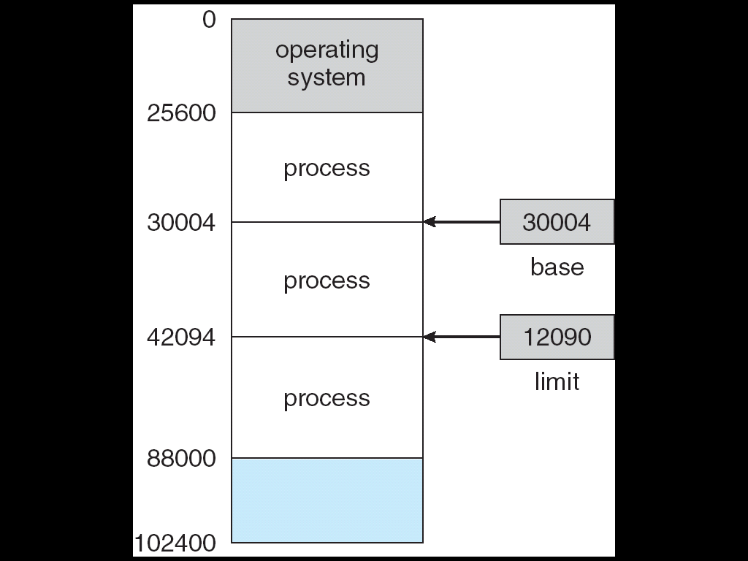
Base and a limit register
A pair of base and limit registers define the logical address space
CPU must check every memory access generated in user mode to be sure it is between base and limit for that user
Notes:
7

Slide 8
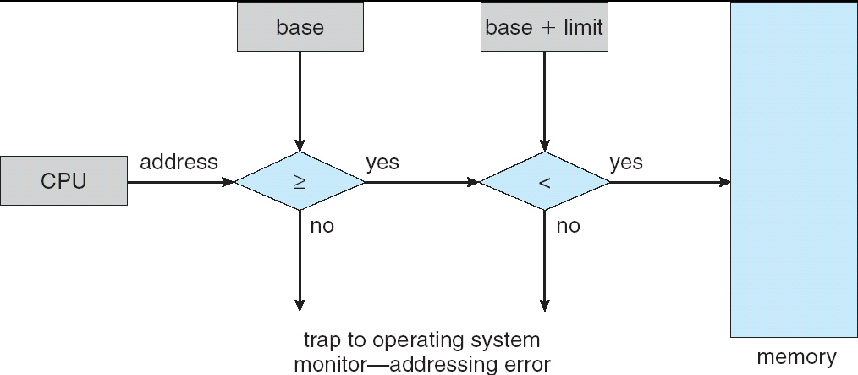
HW address protection with base and limit registers

Slide 9
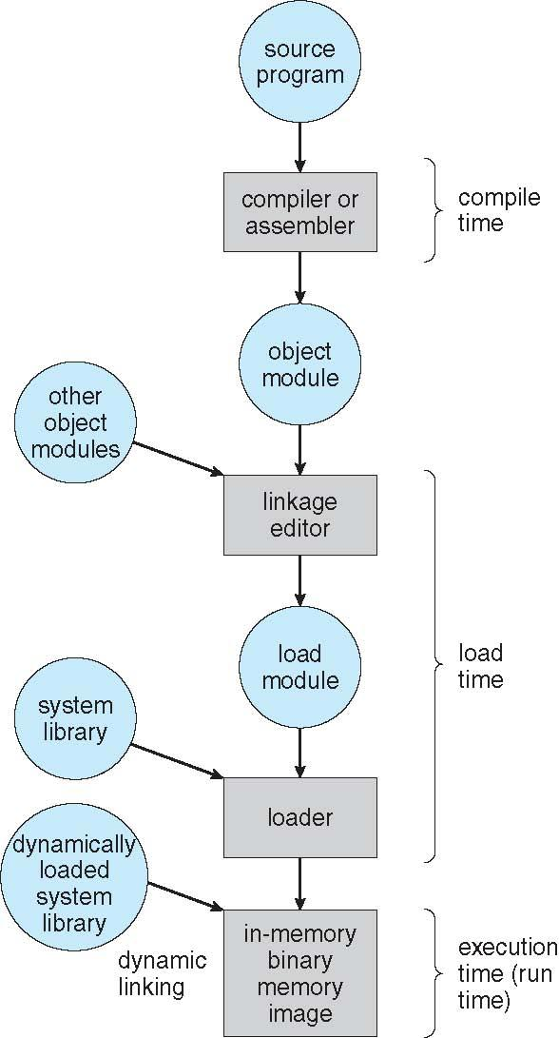
Multistep of address Binding
Notes:
9

Slide 10
Dynamic Loading
As we have discussed so far, the entire program and all data of a process must be in physical memory for the process to execute.
The size of a process is thus limited to the size of physical memory.
To obtain better memory-space utilization, we can use dynamic loading.
With dynamic loading, a routine is not loaded until it is called
Advantages:
An unused routine is never loaded.
This method is particularly useful when large amounts of code are needed to handle infrequently occurring cases.

Slide 11
Dynamic Loading
All routines are kept on disk in a re-locatable load format.
The main program is loaded into memory and is executed.
When a routine needs to call another routine, the calling routine first checks to see where the other routine has been loaded.
If not, the rel-ocatable linking loader is called to load the desired routine into memory and to update the program’s address tables to reflect this change.
Then control is passed to the newly loaded routine.
-------------------------------------------------------------------------
Dynamic loading does not required special support from the Operating System.
It is the responsibility of the users to design their programs to take advantage of such a method.

Slide 12
Dynamic Linking
When a programs runs, apart from its own modules, it also needs to use certain System Libraries as well.
Static linking – system libraries are treated like any other object module and are combined by the loader into the binary program image.
This requirement wastes both disk space and main memory
Dynamic linking –linking postponed until execution time.
Small piece of code, stub, used to locate the appropriate memory-resident library routine
Stub replaces itself with the address of the routine, and executes the routine.
When the stub is executed OS checks if routine is in memory
If not in memory, the program loads the routine into memory.

Slide 13
Logical vs. Physical Address Space
Logical address – an address generated by the CPU;
Physical address – an address seen by the memory management unit.
Logical and physical addresses are the same in compile-time and load-time address-binding schemes; logical (virtual) and physical addresses differ in execution-time address-binding scheme. In this case, we usually refer to the Logical address as a virtual address.
Logical address space is the set of all logical addresses generated by a program.
Physical address space is the set of all physical addresses corresponding to these logical addresses.

Slide 14
Memory-Management Unit (MMU)
The run-time mapping from virtual to physical addresses is done by a hardware device called memory management unit.
In MMU scheme, the value in the relocation register is added to every address generated by a user process at the time it is sent to memory
The user program deals with logical addresses; it never sees the real physical addresses

Slide 15
Memory-Management Unit (MMU)
Hardware device that at run time maps virtual to physical address.
To start, consider simple scheme where the value in the relocation register is added to every address generated by a user process at the time it is sent to memory
Base register now called relocation register
MS-DOS on Intel 80x86 used 4 relocation registers
The user program deals with logical addresses; it never sees the real physical addresses.
Execution-time binding occurs when reference is made to location in memory
Logical address bound to physical addresses.

Slide 16
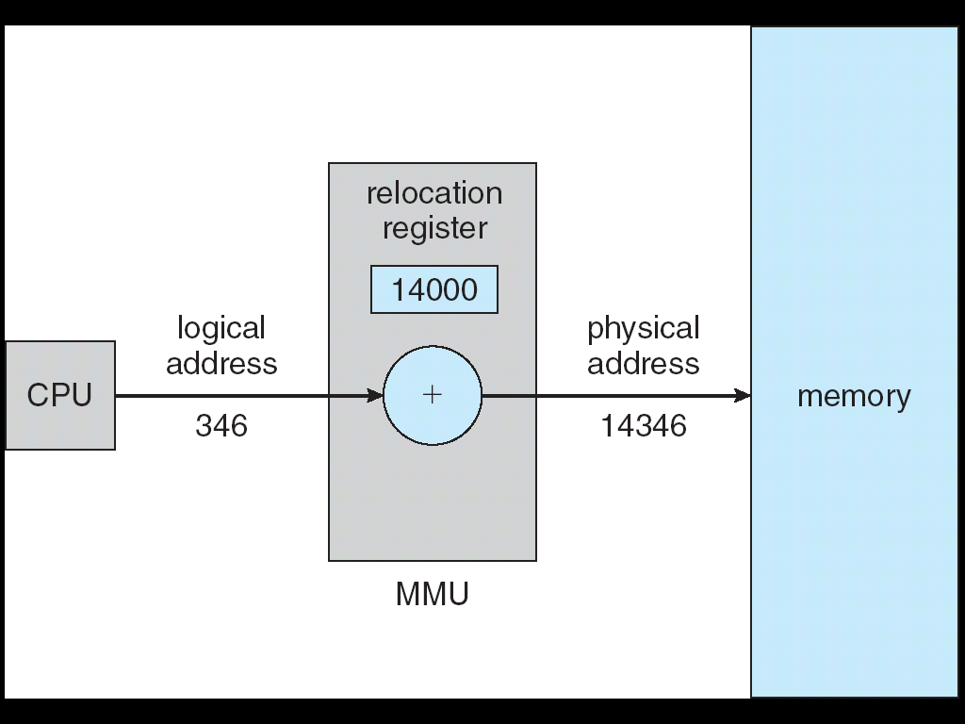
Dynamic relocation using a relocation register

Slide 17
Memory Management Technique
In operating system, following are four common memory management technique
Contiguous Allocation : the contiguous memory allocation assigns the consecutive blocks of memory to a process requesting for memory.
Fixed-partitioned –equal size allocation / Static/ MFT
Variable size partitioned/ dynamic/ MVT
Non-Contiguous Allocation : the noncontiguous memory allocation assigns the separate memory blocks at the different location in memory space in a nonconsecutive manner to a process requesting for memory.
Paged memory management
Segmented memory management

Slide 18
Memory Allocation
Multiple-partition allocation/ Contiguous Allocation :
Hole – block of available memory; holes of various size are scattered throughout memory or we can say, divide memory into several fixed-size partitions.
Each partition may contain exactly one process.
When a process arrives, it is allocated memory from a free hole or partition.
Operating system maintains information about: a) allocated partitions b) free partitions (hole)
When the process terminates, the partitions becomes available for another process.

Slide 19
Memory Allocation using MFT
Memory Allocation using MFT/ Fixed-partitioned-equal size or variable size:
In fixed scheme, the OS will divided the memory into fixed sized blocks. It takes place at the time of installation. Degree of multiprogramming is not flexible. This is because the number of blocks is fixed resulting in memory wastage due to fragmentation.
Disadvantage
Internal Fragmentation
External Fragmentation
Size of process
Fixed degree of Multiprogramming

Slide 20
Storage-Allocation Algorithm
How to satisfy a request of size n from a list of free holes
First-fit: Allocate the first hole that is big enough
Best-fit: Allocate the smallest hole that is big enough; must search entire list, unless ordered by size. Produces the smallest leftover hole.
Worst-fit: Allocate the largest hole; must also search entire list. Produces the largest leftover hole.
First-fit and best-fit better than worst-fit in terms of speed and storage utilization

Slide 21
Memory Allocation using MVT
Variable size fixed-partition/ dynamic/ MVT in Contiguous Allocation
The requirement of memory management is to provide ways to dynamically allocate portions of memory to programs at their request, and free it for reuse when no longer needed.
In variable partitioning scheme there are no partitions at the beginning. There is only the OS area and the rest of the available RAM. The memory is allocated to the processes as they enter. This method is more flexible as there is no internal fragmentation and there is no size limitation and the degree of multiprogramming is dynamic.
It’s limitation is external fragmentation.
OS
OS
OS
OS
process 5
process 5
process 5
process 5
process 9
process 9
process 8
process 10
process 2
process 2
process 2
process 2

Slide 22
Dynamic Storage-Allocation/MVT
Reduce external fragmentation by compaction
Shuffle memory contents to place all free memory together in one large block
Compaction is possible only if relocation is dynamic, and is done at execution time
I/O overhead
-------------------------------------------------------------------------------
Compaction is not good solution for external fragmentation, because we have to invest considerable amount of time for the movement of processes.
During this, execution of other process is stopped. So, it is expensive and it is not considered as a good solution for external fragmentation.

Slide 23
Fragmentation
External Fragmentation – total memory space exists to satisfy a request, but it is not contiguous
Internal Fragmentation – allocated memory may be slightly larger than requested memory; this size difference is memory internal to a partition, but not being used.

Slide 24
Paging
Paging is another memory management scheme that offers a process to be non-contiguous. Paging avoids external fragmentation and the need for compaction.
So, paging is a memory management scheme that permits the physical address space of a process to be non-contiguous.
Divide physical memory into fixed-sized blocks called frames (size is power of 2, between 512 bytes and 8192 bytes)
Divide logical memory into blocks of same size called pages.
Page size = Frame size
To run a program of size n pages, need to find n free frames and load program
When a process is to be execute, its pages are loaded into any available memory frames from the backend store.
Set up a page table to translate logical to physical addresses
Internal fragmentation

Slide 25
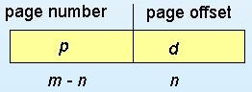
Address Translation Scheme
Translation of Logical Address to Physical Address using page table.
Address generated by CPU is divided into two parts:
Page number (p) – used as an index into a page table which contains base address of each page in physical memory
Page offset (d) – is the displacement within the page. combined with base address to define the physical memory address.

Slide 26
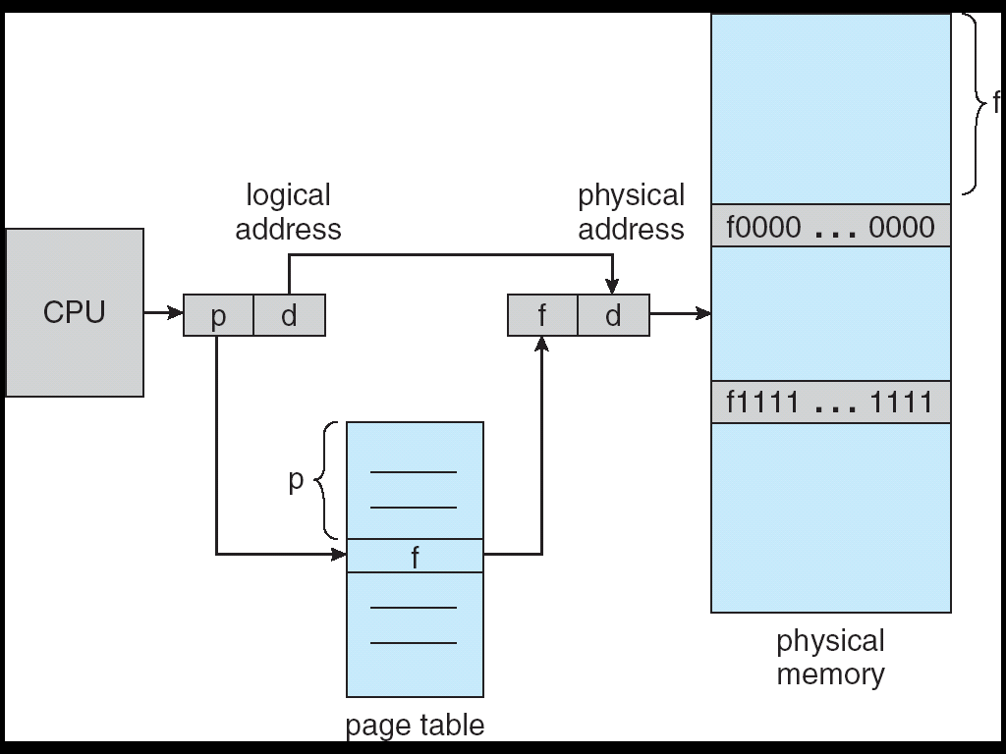
Address Translation Architecture/ Paging h/w

Slide 27
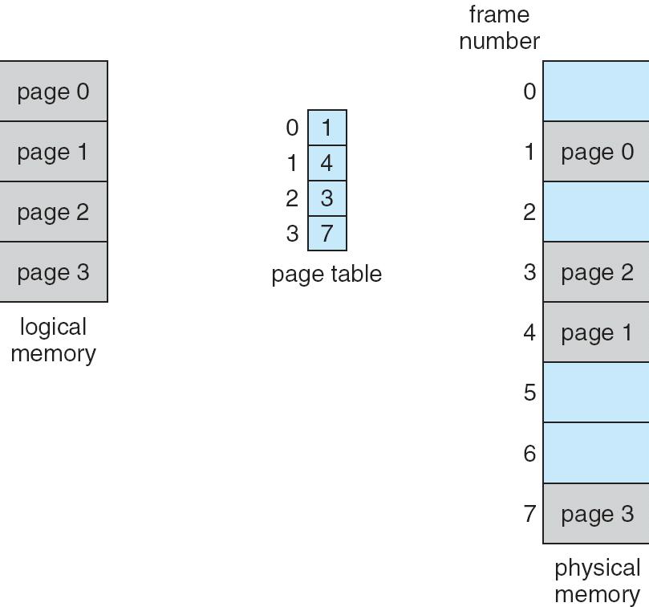
Paging Example

Slide 28
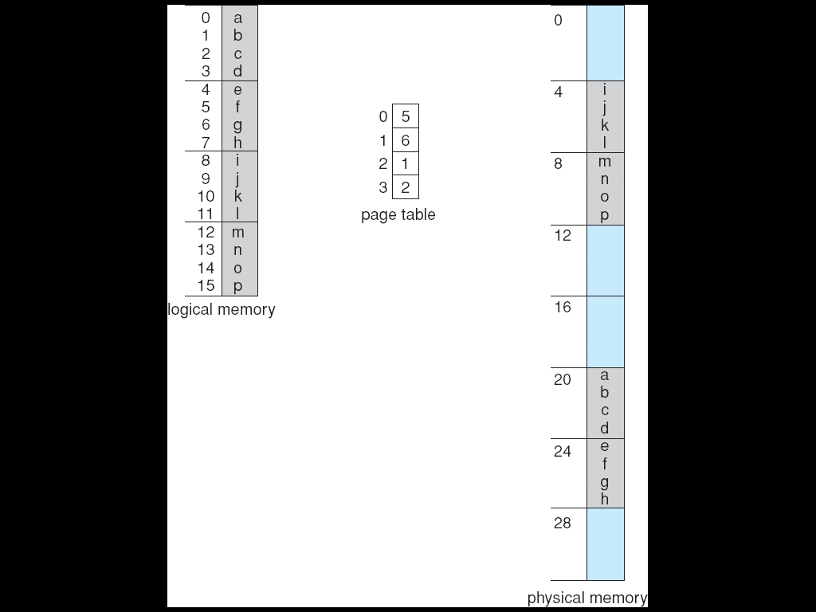
Paging Example

Slide 29
Paging Example from book
As a concrete (although minuscule) example, consider the memory in Figure 8.12. Using a page size of 4 bytes and a physical memory of 32 bytes (8 pages), we show how the programmer’s view of memory can be mapped into physical memory. Logical address 0 is page 0, offset 0. Indexing into the page table, we find that page 0
is in frame 5. Thus, logical address 0 maps to physical address 20 [= (5 × 4) + 0]. Logical address 3 (page 0, offset 3) maps to physical address 23 [= (5 × 4) + 3]. Logical address 4 is page 1, offset 0; according to the page table, page 1 is mapped to frame 6. Thus, logical address 4 maps to physical address 24 [= (6 × 4) + 0]. Logical address 13 maps to physical address 9.

Slide 30
Discussing limitations of paging
When we use a paging scheme, we have no external fragmentation: any free frame can be allocated to a process that needs it. However, we may have some internal fragmentation. Notice that frames are allocated as units. If the memory requirements of a process do not happen to coincide with page boundaries, the last frame allocated may not be completely full. For example, if page size is 2,048 bytes, a process of 72,766 bytes will need 35 pages plus 1,086 bytes. It will be allocated 36 frames, resulting in internal fragmentation of 2,048 − 1,086 = 962 bytes. In the worst case, a process would need n pages plus 1 byte. It would be allocated n + 1 frames, resulting in internal fragmentation of almost an entire frame. If process size is independent of page size, we expect internal fragmentation to average one-half page per process

Slide 31
Paging (Cont.)
Calculating internal fragmentation
Page size = 2,048 bytes
Process size = 72,766 bytes
35 pages + 1,086 bytes= 36 frames needed
Internal fragmentation of 2,048 - 1,086 = 962 bytes
Worst case fragmentation = 1 frame – 1 byte
On average fragmentation = 1 / 2 frame size
So small frame sizes desirable?
But each page table entry takes memory to track
Page sizes growing over time
Solaris supports two page sizes – 8 KB and 4 MB
Process view and physical memory now very different
By implementation process can only access its own memory

Slide 32
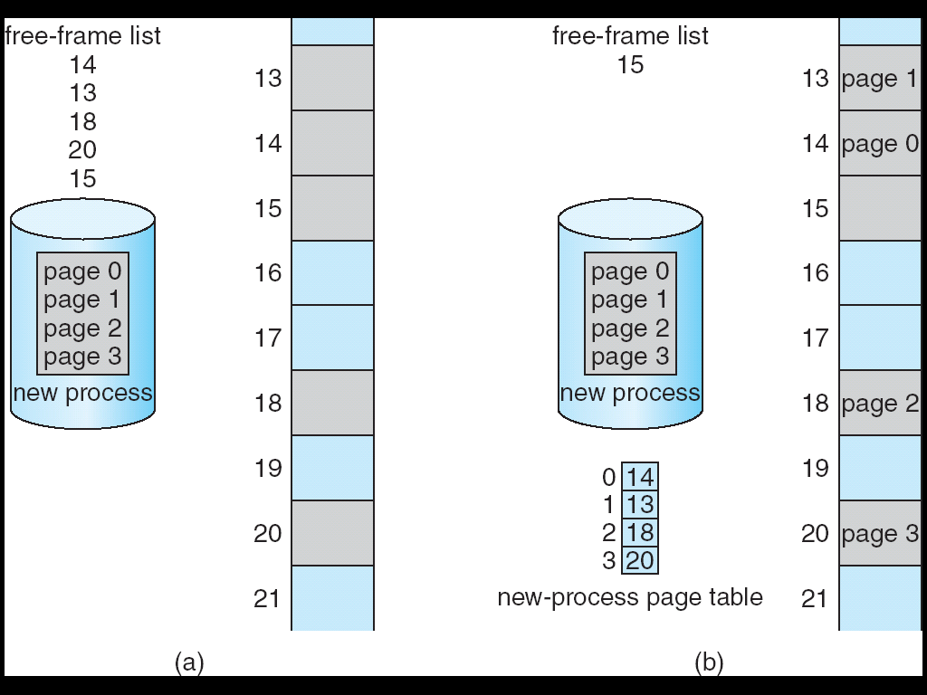
Free Frames
Before allocation
After allocation

Slide 33
Hardware Implementation of Page Table
1st case:
We can implement the page table as a set of dedicated registers.
But this can be used only when page table is reasonably small.

Slide 34
Hardware Implementation of Page Table
2nd case:
Page table is kept in main memory and
Page-table base register (PTBR) points to the page table
Page-table length register (PTLR) indicates size of the page table
In this scheme every data/instruction access requires two memory accesses
One for the page table and one for the data / instruction
-------------------------------------------------------------------------
The two memory access problem can be solved by the use of a special fast-lookup hardware cache called associative or high speed memory or translation look-aside buffers (TLBs)
It consists of two parts: A key, A value.
The search is fast.

Slide 35
Hardware Implementation of Page Table
TLB contents only a few of the page table entries.
When a logical address is generated by the CPU, its page number is presented to the TLB.
If the page number is found, its frame number is immediately available and used to access memory →TLB Hit
If the page number is not in the TLB, a memory reference to the page table must be made →TLB Miss
When the frame number is obtained, we can use it to access memory.
Also we add the page number and frame number to the TLB on a TLB miss, so that they will be found quickly on the next reference.
TLBs typically small (64 to 1,024 entries)
Replacement policies must be considered
Some entries can be wired down for permanent fast access

Slide 36
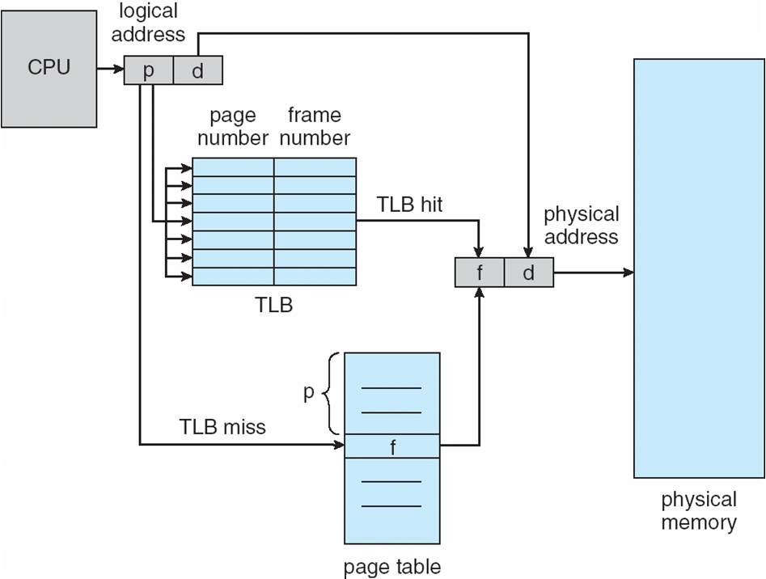
Paging Hardware With TLB

Slide 37
Effective Memory Access Time
The percentage of times that the page number of interest is found in the TLB is called the hit ratio. An 80-percent hit ratio, for example, means that we find the desired page number in the TLB 80 percent of the time. If it takes 100 nanoseconds to access memory, then a mapped-memory access takes 100 nanoseconds when the page number is in the TLB. If we fail to find the page number in the TLB then we must first access memory for the page table and frame number (100 nanoseconds) and then access the desired byte in memory (100 nanoseconds), for a total of 200 nanoseconds. (We are assuming that a page-table lookup takes only one memory access, but it can take more, as we shall see.)

Slide 38
Effective Memory Access Time
associative Lookup = ε time unit
Can be < 10% of memory access time
Hit ratio = α
Hit ratio – percentage of times that a page number is found in the associative registers; ratio related to number of associative registers
Consider α = 80%, ε = 20ns for TLB search, 100ns for memory access
EAT = 0.80 x 120 + 0.20 x 200 = 136ns
Consider more realistic hit ratio -> α = 99%, ε = 20ns for TLB search, 100ns for memory access
EAT = 0.99 x 120 + 0.01 x 200 = 120.8ns

Slide 39
Shared Pages
An advantage of paging is the possibility of sharing common code.
This is particularly important in a time sharing environment.
Consider a system that supports 40 users, each of whom executes a text editor.
If the text editor consists of 150KB of code and 50KB of data space, we need:
(150 X 40) + (50 X 40)
= 6000 + 2000
= 800KB to support the 40 users

Slide 40
Shared Pages
However, if the code is reentrant code (or pure code), it can be shared among different processes
Reentrant code means the code that is non-self-modifying code. It never changes during executions.
Thus two or more processes can execute the same code at the same time.
Each process has its own copy of registers and data storage to hold the data for the process’s execution.
The data for two different processes will, of course, be different.

Slide 41
Shared Pages
An advantage of paging is the possibility of sharing common code.
This is particularly important in a time sharing environment.
Consider a system that supports 40 users, each of whom executes a text editor.
If the text editor consists of 150KB of code and 50KB of data space, we need:
(150 X 40) + (50 X 40)
= 6000 + 2000
= 8000KB to support the 40 users
Now, if the code is shared, we need:
150 + (50 X 40)
= 150 + 2000
= 2150 to support 40 users

Slide 42
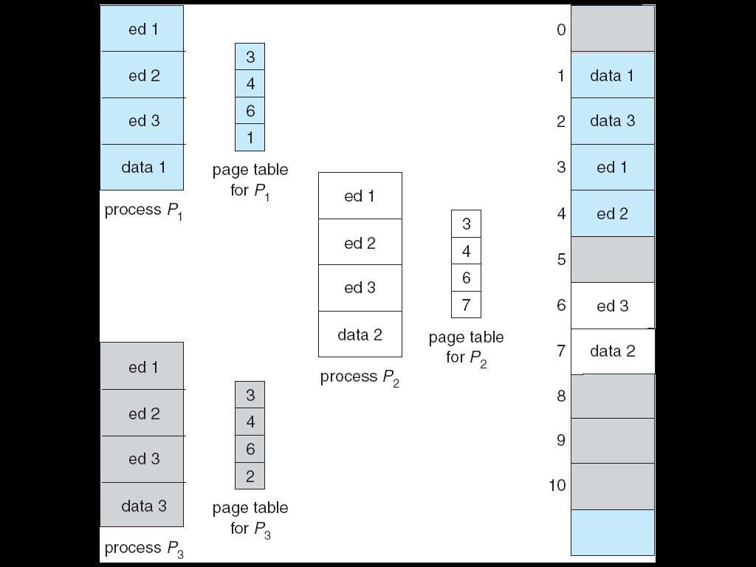
Shared Pages Example

Slide 43
End of Chapter 8

